Slide 1
Careers in Canadian Fluid Power
170309G
Notes:
Hello, and welcome to our webinar. The following PowerPoint was created by our Education Committee to be used as a resource for those considering a career in Fluid Power. If you have any questions as we go through this presentation please type them into the chat box. We will answer as many as we can at the end of the presentation and will email out the responses to all attendees.

Slide 2
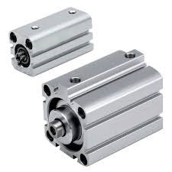
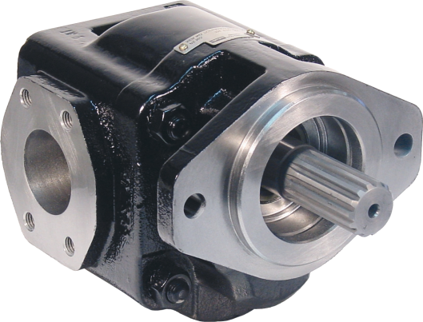
FLUID POWER = Hydraulic + Pneumatics
Has and will continue to play a major role in powering the equipment that a modern society needs to sustain itself and grow
Is a technology and industry with excellent job opportunities
Notes:
- What is Fluid Power? It is a combination of hydraulics and pneumatics.
It affects our everyday life, playing a major role in powering the equipment that makes our modern life possible – and there are many challenging and rewarding career opportunities available.

Slide 3
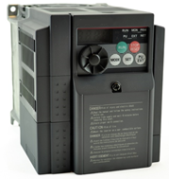
Fluid Power + Electronics = “Smart Systems”
Improve accuracy and repeatability
Smoother, predictable motion control
Self monitoring and diagnostics using sensors
Increase safety by incorporating interlocks
Remote control of equipment
Increased energy efficiency
Automation
Notes:
Increasingly, Fluid Power is being combined with Electronics to produce what are known as Smart Systems. These systems offer…

Slide 4
Industries in which Fluid Power plays a significant role
Notes:
The following are industries in which Fluid Power plays a significant role.

Slide 5
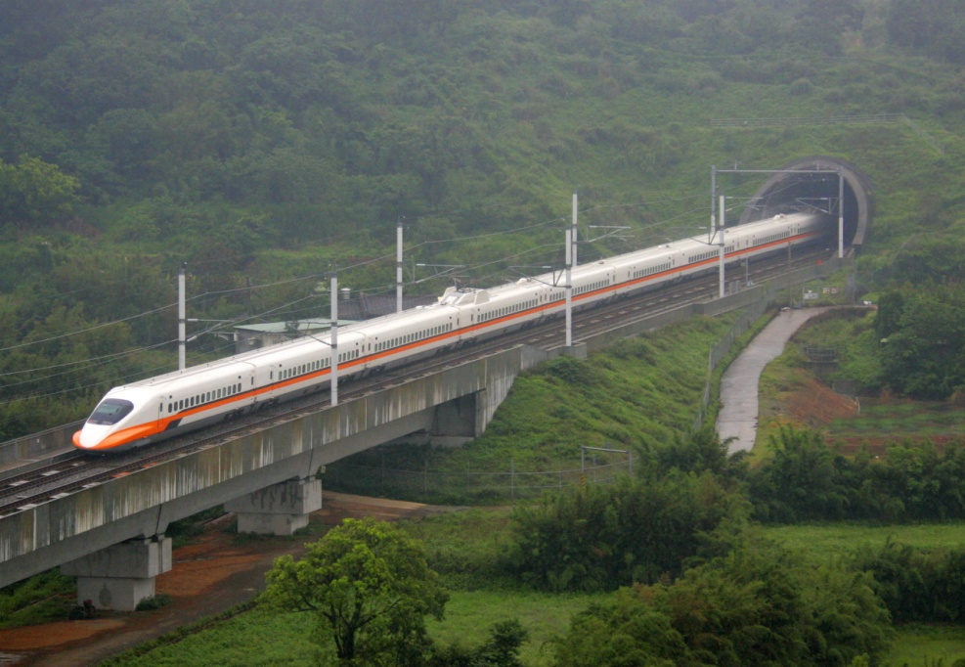
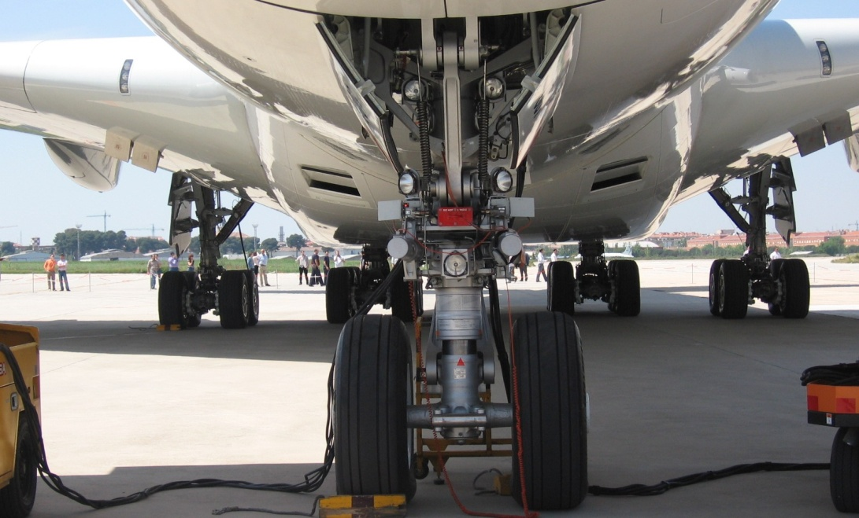
Transportation
Notes:
Transportation is an industry involved in the movement of people or cargo. It affects everything from deep beneath the water’s surface to high in the air.
Aerospace
Landing Gear
Flight control surfaces
Brakes
Rail
Doors
Leveling system
Suspension
Brakes

Slide 6
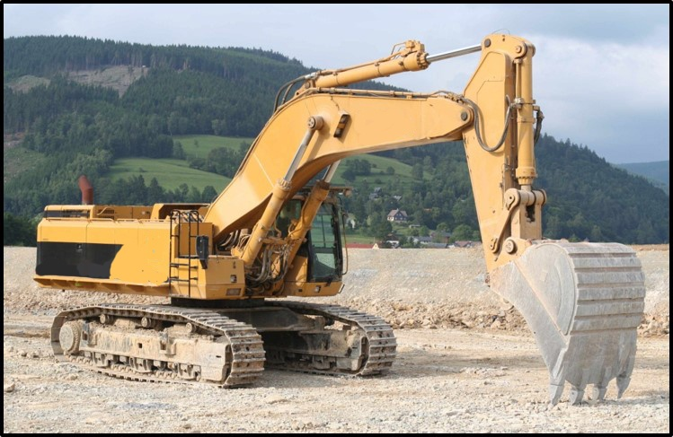
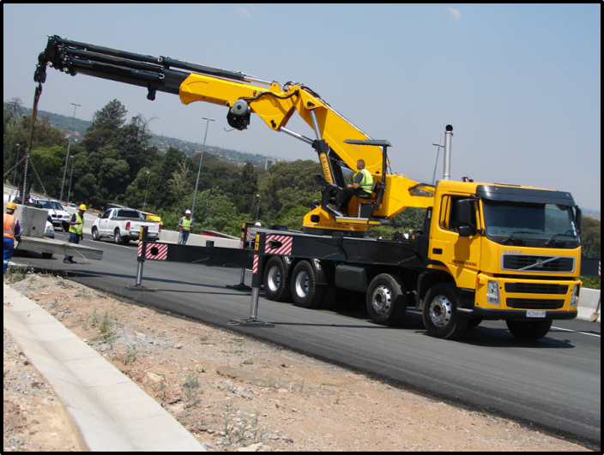
Construction
Notes:
There are cylinders, pumps and motors on almost every piece of construction equipment from dump trucks to excavators.

Slide 7
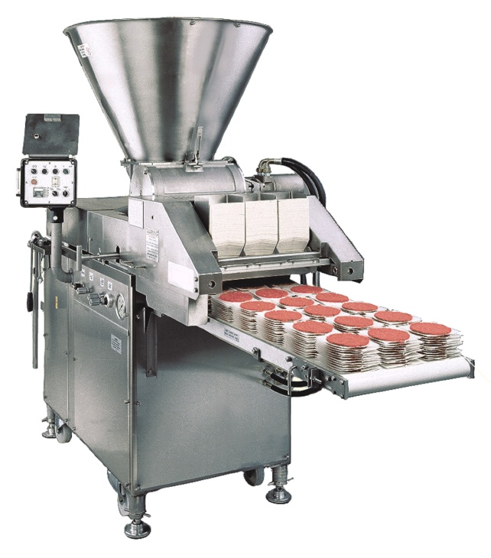
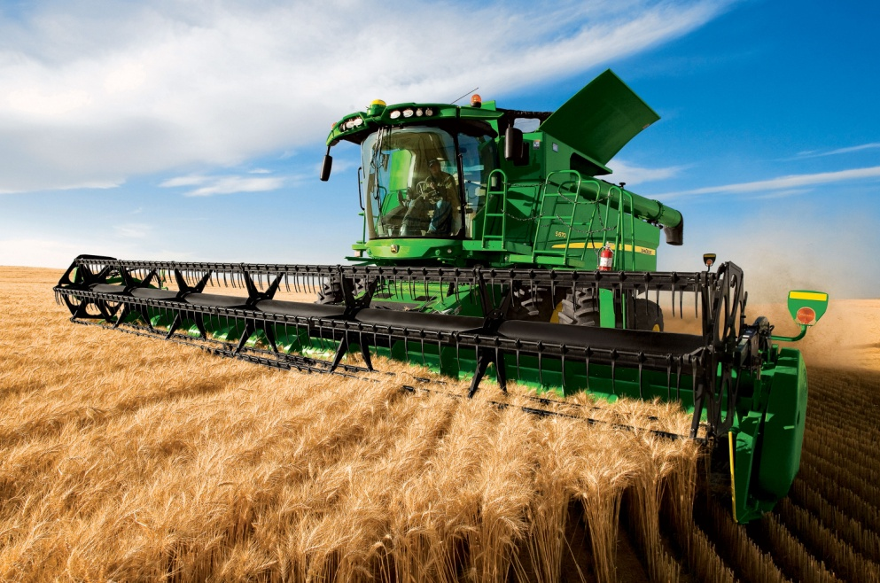
Food
Notes:
The Food industry benefits from Fluid Power in all aspects from planting and harvesting to processing and packaging to allow for mass scale food production.
Food Processing / Packaging
Grinding
Conveyor
Stacking
Pressing
Sorting
On the Farm
Drive
Steering
Hydraulic Motors to spin the cutter
Hydraulic cylinders
Conveyors

Slide 8
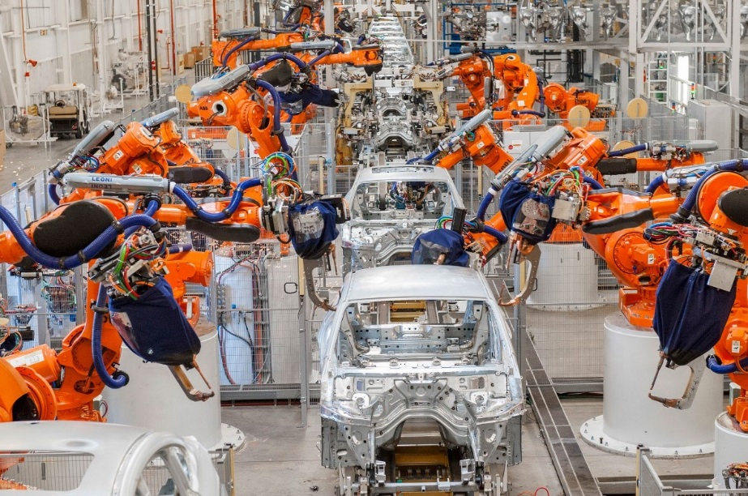
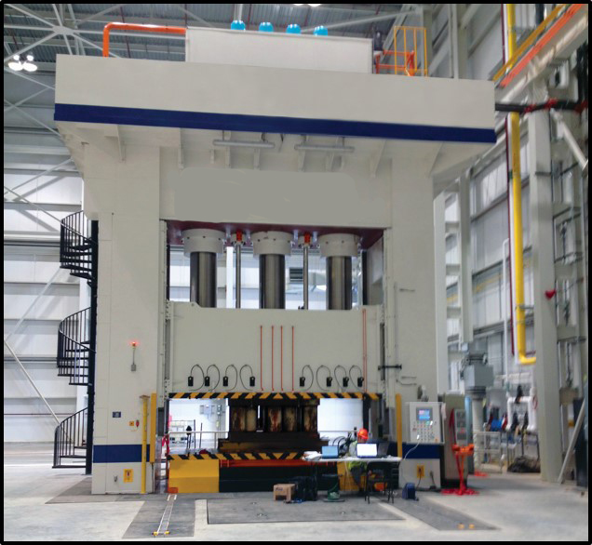
Manufacturing
Notes:
Fluid Power has streamlined the manufacturing process and created safer, more precise, state-of-the-art production facilities.
Press Control
Controlled movement at selected speeds
Pressure control to form parts at high tonnage
Transferring parts in and out of the press
Other Manufacturing
Assembly line tools , torque wrenches , drills , etc.
Pick and placement of parts for assembly

Slide 9
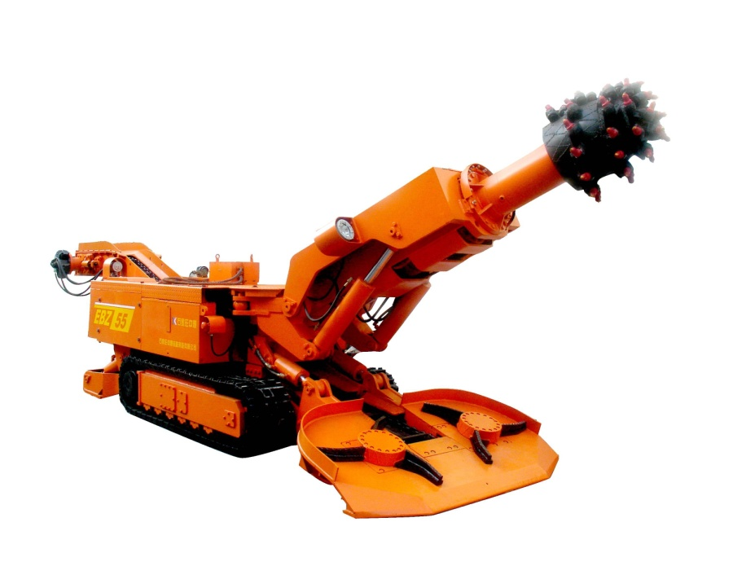
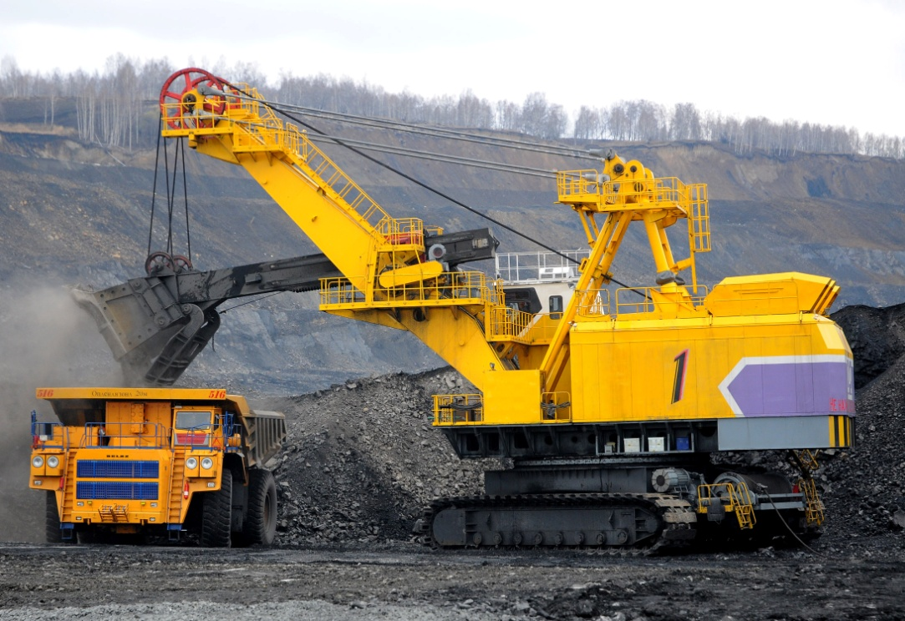
Mining
Notes:
The Mining industry is experiencing increased mass output and a focus on providing safer environments for workers. Both of these are achieved with the use of fluid power!
Vehicle Drive
Operating any of the attachments
Controlled manipulation of the attachments
Vehicle stability

Slide 10
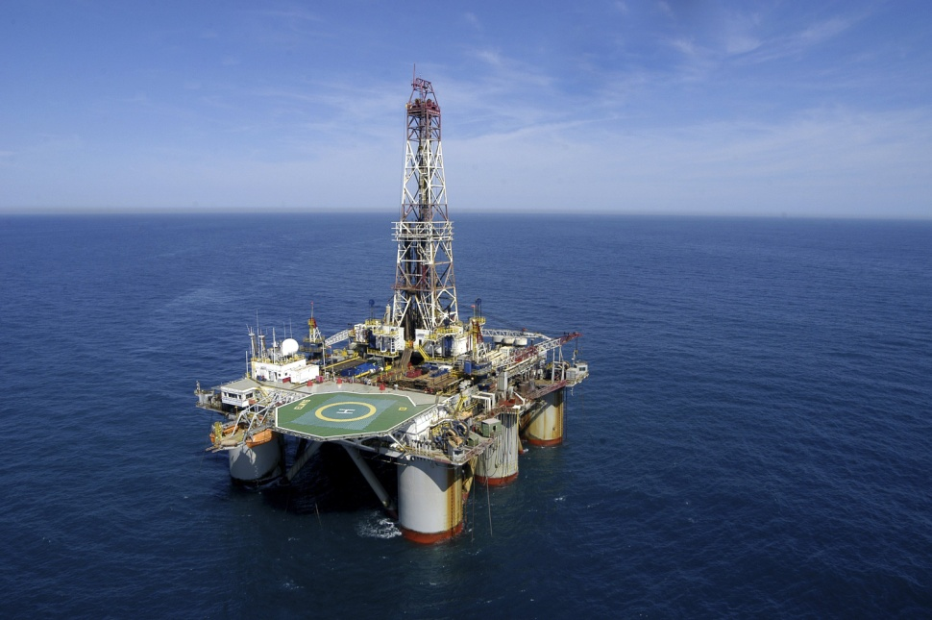
Energy
Notes:
Fluid Power aids in the advancement of eco-friendly energy production in areas such a wind turbines. Fluid Power also contributes to the traditional extraction of energy.
Wind Turbines
Blade angle Control
Brake - to prevent spinning
Future - replacing gearbox with hydraulic Motor/ Pump arrangements
Oil Rig,
Drilling functions
Handling , assembly and tightening of drilling tubes

Slide 11
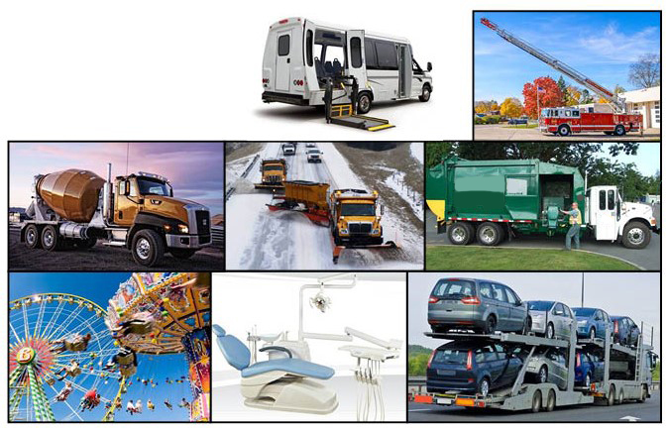
Everyday
Notes:
You will find pneumatics and hydraulics in use in our everyday lives. Anywhere that a power-dense, safe, and reliable source of power is needed to create a controlled movement.
Pretty well any where that something needs to move.
Turn the Drum on a Cement Truck
Rotate and Lift the ladder on the fire Truck
Lift the Wheel chair on the accessibility Van
Lift and angle the Plow and spin the salt spreader on the Snow Plow
Lift , rotate and compress the trash on a garbage truck
Pretty well on all amusement park rides,
Angle your dentist chair… operate some high speed drills
Stack the cars on a auto transport.

Slide 12
The Canadian Fluid Power Industry meets the Hydraulic and Pneumatic needs of these well established and cutting edge industries in many ways.

Slide 13
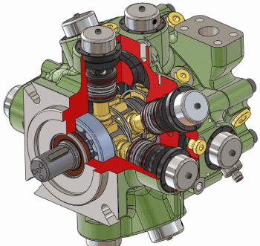
Fluid Power Industry Products and Services
Components
Pumps, Motors, Valves, Accumulators, Filtration
Systems
Hydraulic Power Units, Pressure Testing Equipment
Services
Repairs (bench or field)
Maintenance
Installations
Design Engineering
Notes:
The Fluid Power industry is typically broken down into the following categories: Products, which can be further broken down into components and systems, as well as the services used to maintain those components and systems.

Slide 14
Fluid Power (FP) Industry Types of Companies
Manufacturers | Make FP components and systems
Distributors | Sell FP components and systems
Machine Builders | Design & make systems for end users
End Users | Companies that use FP components & systems
Service Companies | Repair and maintain FP equipment
Consulting Engineers | Design FP systems
Notes:
Here is a list of the various types of companies within the Fluid Power Industry. We will review each more closely in the following slides. Different types of companies interact quite a bit with each other. For example, the products that manufacturers produce are often sold through distributors to machine builders, end users and service companies.

Slide 15
Fluid Power Industry Manufacturers
Research and development of new products
Design of their own production facilities
Production maintenance
Technical support
Field sales and territory management
Notes:
Manufacturers make Fluid Power components and systems. Numerous activities at manufacturers provide career opportunities. These include …

Slide 16
A few Fluid Power Manufacturers
Notes:
They key players shown here are proud members of the Canadian Fluid Power Association.

Slide 17
Fluid Power Industry Distributors
Warehousing and reselling of components
Packaging of components into kits
Simple assembly of components
Manufacturing of systems
Engineering services
Field and bench service
Notes:
There is a lot going on at your typical fluid power distributor including …

Slide 18
Fluid Power Industry Machine Builders
Design and build specialized or multi-purpose machines or sub-assemblies
Examples include packaging equipment, welding robots, off-road equipment
Notes:
Machine Builders utilize fluid power to…

Slide 19
Fluid Power Industry End Users
Use fluid power components or systems in their production processes, e.g. hydraulic cylinders on stamping presses
Production engineering – improving efficiency
Maintenance, e.g. filtration, to prevent breakdowns.
Notes:
End users use fluid power components or systems in their production processes.
Career opportunities at end user companies include production engineering and maintenance.

Slide 20
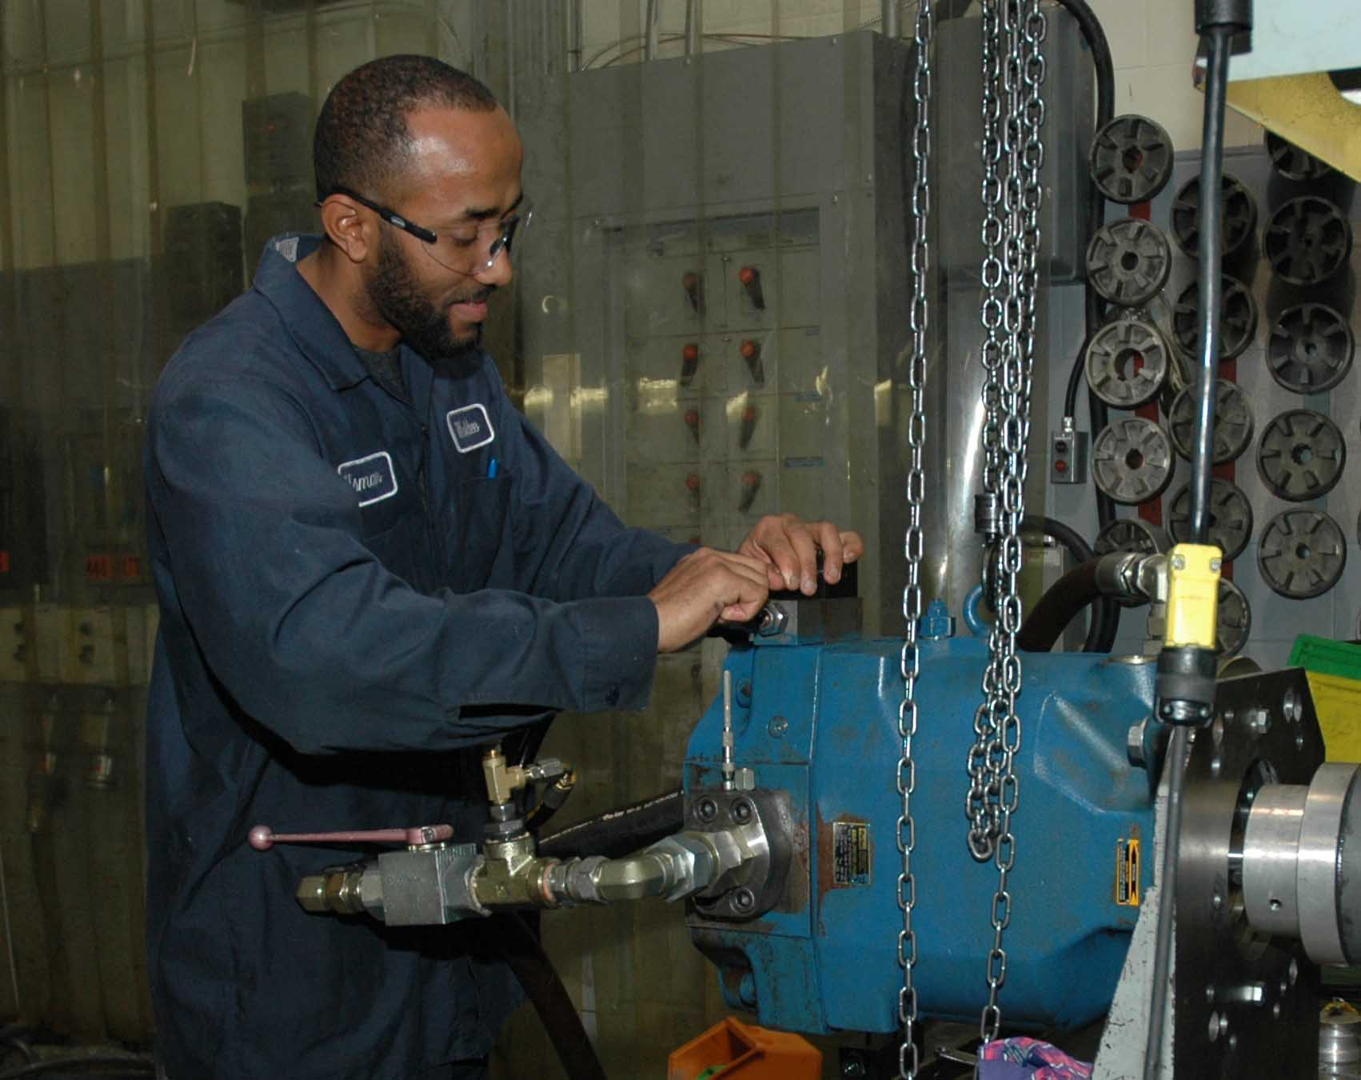
Fluid Power Industry Service Companies
Repair and maintain fluid power components or systems usually at end users
Notes:
Service Companies repair and maintain fluid power components and systems.

Slide 21
Fluid Power Industry Consulting Engineers
Design fluid power systems, usually made by machine builders, that become production equipment at end users
Notes:
Consulting Engineers are the ones who design fluid power systems which end up being made by machine builders with a final destination of becoming production equipment at end users.

Slide 22
What types of jobs?
Inside Sales – Tech Support – Customer Service
Outside Sales – Sales Engineer
Fluid Power Systems Design
Service and Assembly Technician
Notes:
Within these various industries there are many different types of jobs which will be covered in the following slides.

Slide 23
A word about “SALES”
Sales in the Fluid Power Industry is not high pressure, one-time selling
Industrial Sales is all about building relationships
In many cases it’s more about “Consulting” than “Selling”. Examples include helping a customer:
Design a hydraulic system for new equipment or to improve existing machinery.
Troubleshoot system anomalies.

Slide 24
INSIDE SALES (aka Technical Support or Customer Service)
Training/Education
A college diploma or certificate in a field including or related to fluid power, e.g. Mechanical Engineering Technology, Automation and Robotics
Personal Attributes
Detail-oriented
Organized
Cautious
Innovative
Somewhat sociable
Salary range: $30,000 - $55,000
Notes:
A person who works in Inside Sales will typically work with clients over the phone or by e-mail. Your clients could include manufacturers, distributors and end users, depending on your company’s product offerings.

Slide 25
OUTSIDE SALES (aka Sales Engineering)
Training/Education
Mechanical engineering degree; P. Eng.
A college diploma or certificate in a field including or related to fluid power, e.g. Mechanical Engineering Technology, Automation and Robotics
Personal Attributes
High sense of urgency
Like freedom of action
Self-directed
Seek out challenges
Very sociable
Salary range: $32,000 - $75,000
Notes:
A person who works in Outside Sales will work with clients face-to-face. Their clients will be manufacturers, distributors and end users from any industry. You will help your clients select the right component or system to assist with their specific application – and each one is different!

Slide 26
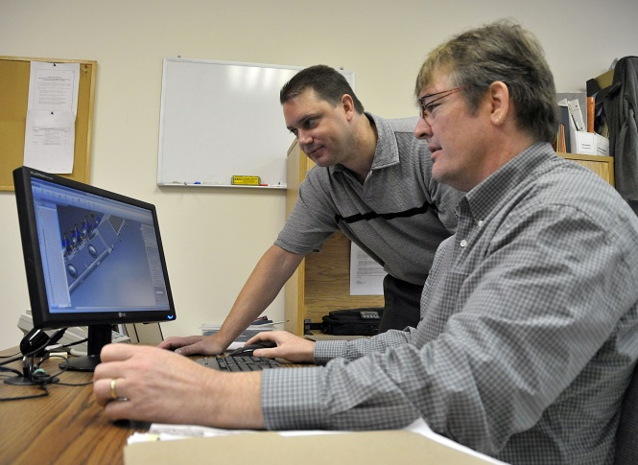
FLUID POWER SYSTEMS DESIGN
Training/Education
Mechanical engineering degree; P. Eng.
A college diploma or certificate in a field including or related to fluid power, e.g. Mechanical Engineering Technology, Automation and Robotics
Personal Attributes
Detail-oriented
Task-focused
Cautious, patient and calm;
Organized & systems-oriented
Salary range: $42,000 - $73,000
Notes:
Those responsible for the design of Fluid Power systems will sometimes work with clients face-to-face but more often will be working with the Outside Sales Rep to design things such as hydraulic power units and pressure testing equipment.

Slide 27
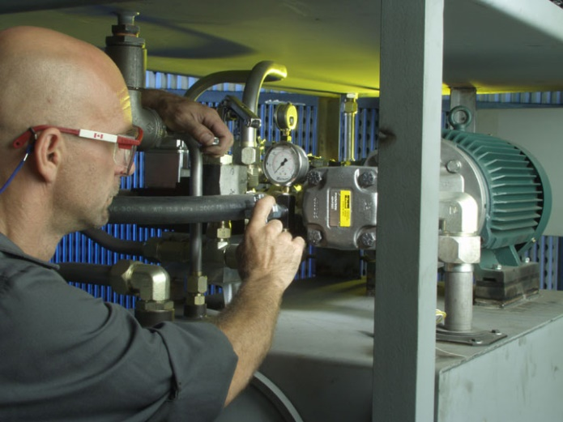
SERVICE & ASSEMBLY TECHNICIAN
Training/Education
A college diploma or certificate in a field including or related to fluid power, such as:
Mechanical Engineering Technology,
Automation and Robotics,
Millwrighting
Personal Attributes
Problem solver
Likes to work hands-on
Salary range: $33,000 - $73,000
Notes:
Service and Assembly Technicians will work with end users, manufacturers, inside and outside sales reps to repair and maintain fluid power components and systems. They are also responsible for the assembly and installation of fluid power components and systems.

Slide 28
What is the CFPA?
Canadian Fluid Power Association
Member include Manufacturers, Distributors and Related Businesses and Organizations, e.g. Trade Journals, Colleges, involved with Fluid Power in Canada
Our focus is the Promotion of Fluid Power Technology, Networking & Education, Market Insight and Industrial Relations.
Our website: www.cfpa.ca
Notes:
CFPA stands for the Canadian Fluid Power Association. Members include manufacturers, distributors and related businesses and organizations with a combined focus on the promotion or fluid power technology, networking and education, market insight and industrial relations.

Slide 29
CFPA and other Fluid Power Industry Resources
Become a Student Member
Check Member Company websites for employment opportunities
Notes:
For anyone currently attending school with an interest in Fluid Power, you can become a Student Member of the CFPA. As a student member, you will have access to the members-only material and will be invited to attend networking events.

Slide 30
CFPA and other Fluid Power Industry Resources
www.cfpa.ca
Notes:
Please visit our website at www.CFPA.ca and click “Careers & Education” for more information.

Slide 31
CFPA and other Fluid Power Industry resources
www.nfpa.com
www.ifps.org
Notes:
The National Fluid Power Association (NFPA) is our sister association based in the USA. Their website, as well as that of the International Fluid Power Association, are great additional resources for anyone considering a career in Fluid Power.

Slide 32
Thank You
Contact Us
info@cfpa.ca 416-735-3911

