Slide 1
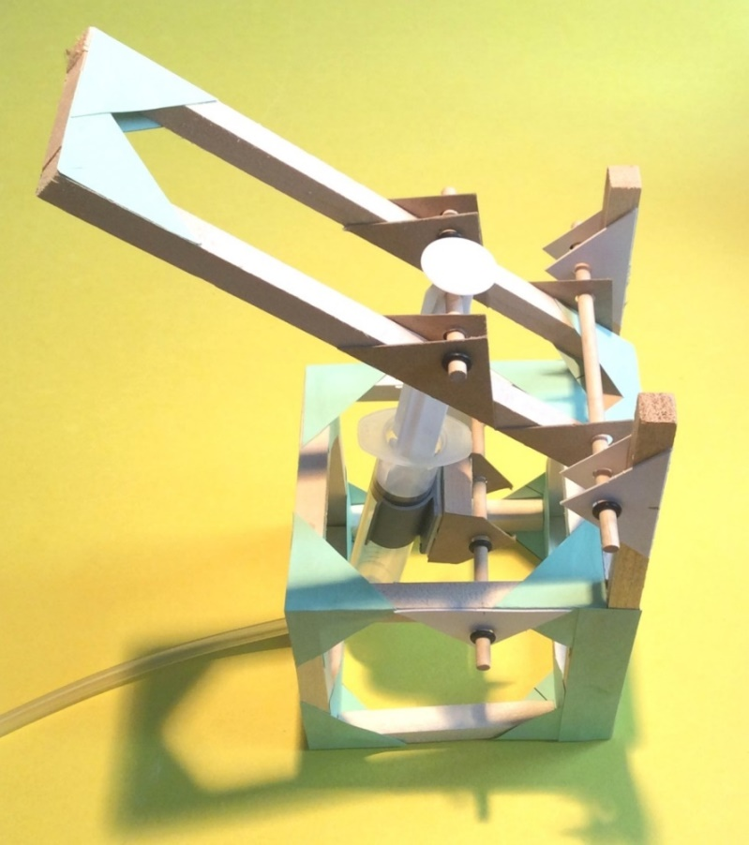
Lifter
Step-by-step assembly instructions

Slide 2
Contents of the Workshop-Lifter Kit
Wooden pieces (1 cm cross-section): 8 X 9 cm; 6 X 8 cm; 4 X 20.25 cm;
2 X 38 mm; 3 X 25 mm
Green corner gussets: 2 cards
Syringes, 20 cc: 2 (1 has a hole in the plunger)
Plastic Tubing: 1 length
Wooden dowel, 5mm diam.: 2 X 12.75 cm; 1 X 7.75 cm
Axle Holders: 16
Syringe Holder: 1
Mini-washers: 8
Stirring Sticks for spreading glue: 2
Plus a small piece of sandpaper

Slide 3
Cutting list for Workshop Lifter
Pieces required for making the cube:
8 pieces 9 cm long
4 pieces 8 cm long
From the pieces left over after making the cube measure and mark the following:
4 pieces 20.25 cm long
2 pieces 8 cm long
2 pieces 38 mm long
3 pieces 25 mm long
Measure carefully twice, check the measurements again and then cut!
Division of labor example: 4 person team
1 person measuring and marking
1 person cutting
1 person sanding cut ends
1 person reading ahead to prepare for the next steps

Slide 4
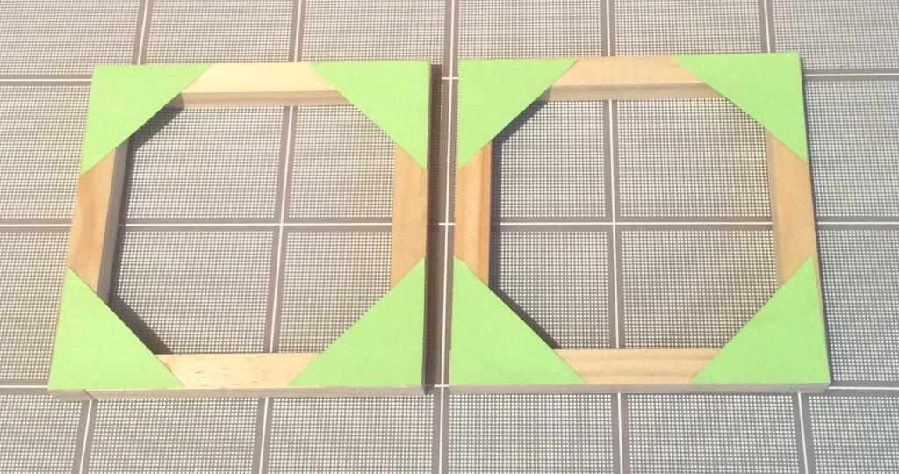
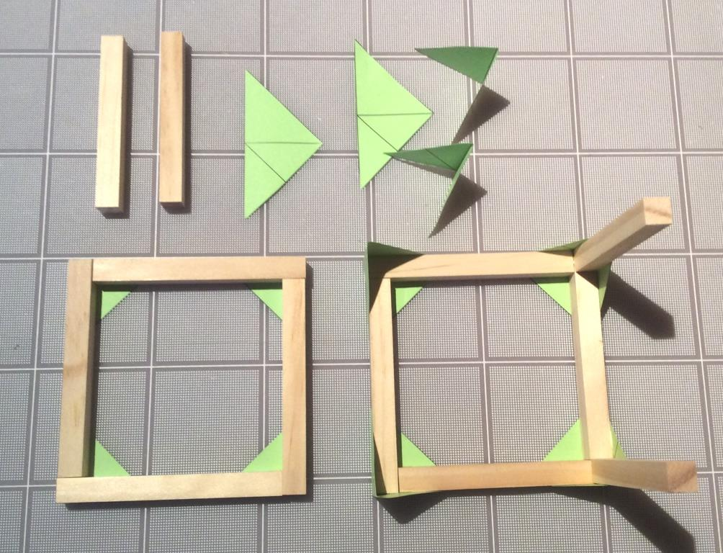
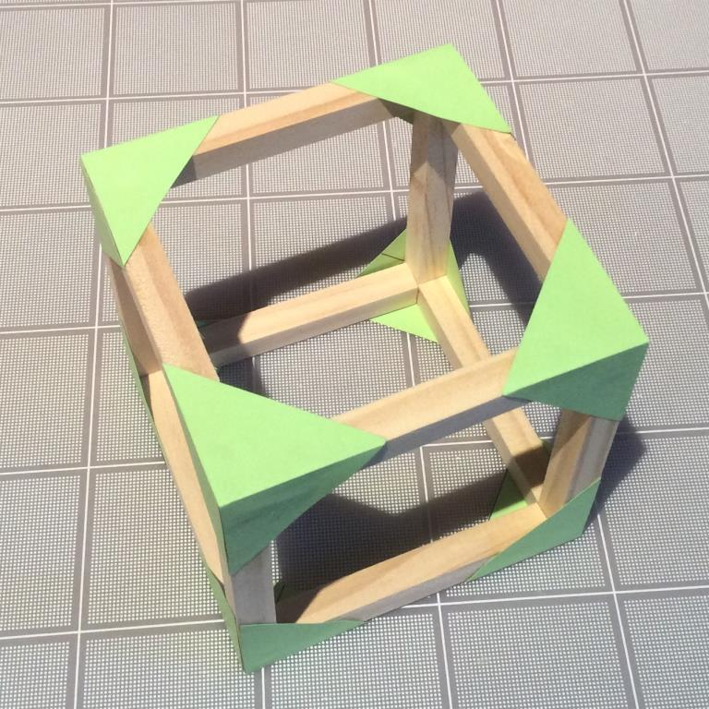
These images show the steps involved in making the cube as set out in the next slide.

Slide 5
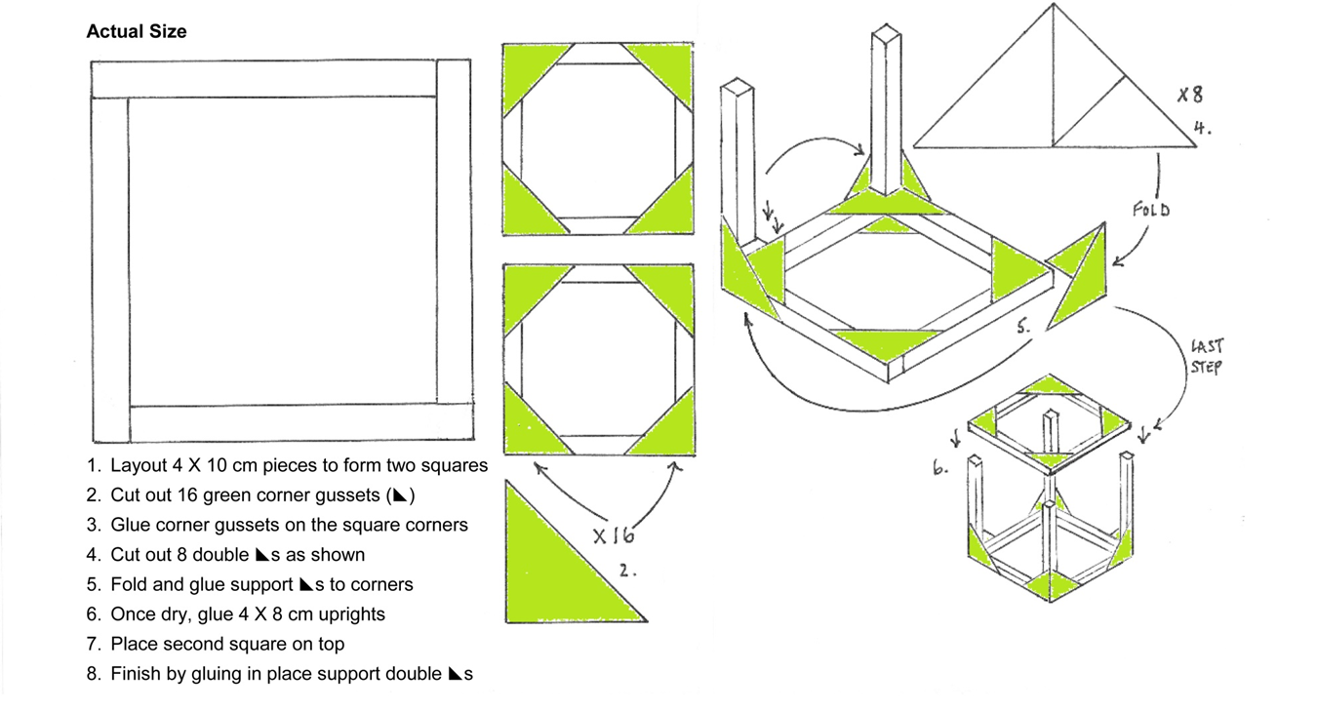
Just in case your team needs help making the cube

Slide 6
Glue two 20.25 cm pieces to one side of the cube. Reinforce by gluing two strips 10cm X 2 cm on the side and the long pieces
Gluing techniques:
Use sparing amounts of glue.
Use craft stick to spread a thin layer of glue at all joints.
Glue wood together 1st then use corner gussets (paper triangles) to reinforce the joints.

Slide 7
Glue two 8 cm pieces between the long uprights and reinforce with four green triangular gussets.

Slide 8
Glue an axle holder onto the outside of the top of the cube as shown. Mark the center of the axle holder and mark 5 cm from the edge furthest from the uprights. Glue the axle holder into position checking it is horizontal and parallel to the 8 cm piece you glued in last

Slide 9
Glue two more axle holders on the inside edges to reinforce. Make sure the holes line up

Slide 10
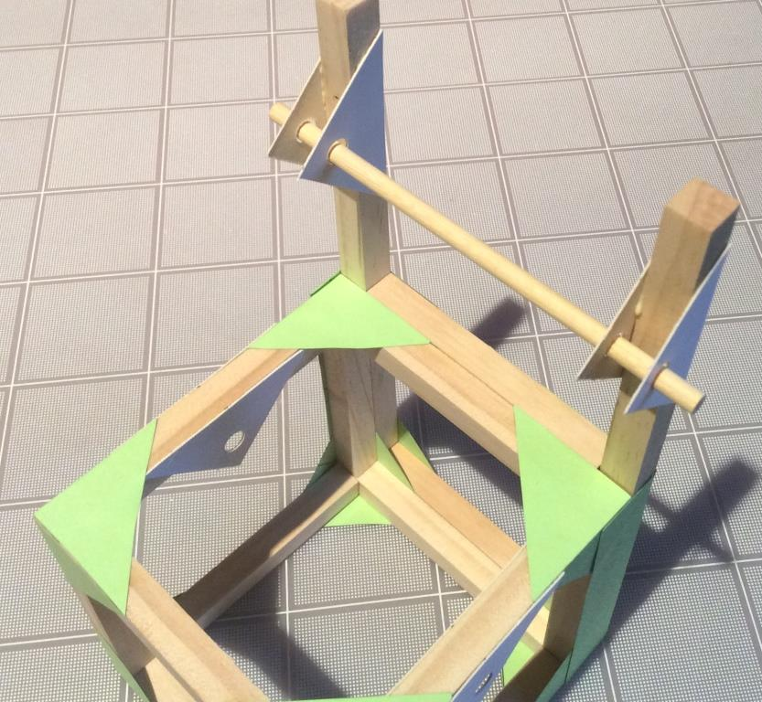
Glue an axle holder onto the outside of so that the centre of the hole is 38 mm from the top of the upright and the hole points towards the cube. Once horizontal and perpendicular to the uprights glue two more axle holders on the inside

Slide 11
Glue together three 25 mm pieces using glue between the pieces. Glue a corner triangular gusset to a largest surface, cutting the excess corner and gluing it into the gap. Glue two axle holders to opposite sides and trim. This is the platform that will hold the acting syringe.

Slide 12
Once everything is dry test in the structure using a longer axle and ensure smooth rotation.

Slide 13
Make the arm by connecting two 20.25 cm pieces and two 38 mm pieces. Use 8 corner gussets – four on each side.

Slide 14
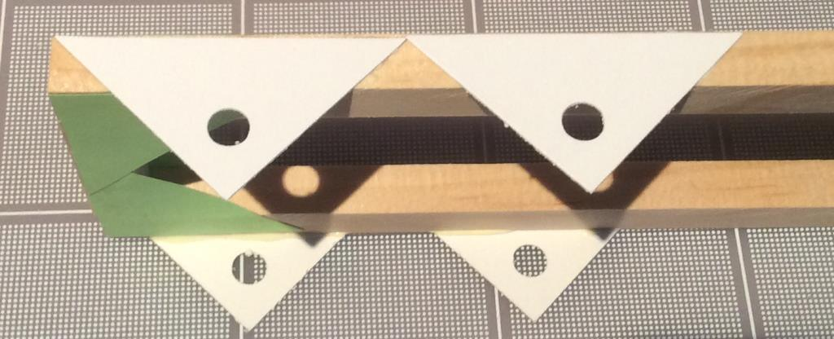
On this frame glue an axle holder in place so that its smallest angle touches the corner of the frame. Use a long axle to align and glue another axle holder on the outside of the opposite side. Test that the long axle sits across the frame parallel to the shortest end. Glue another axle holder in place so that its smallest angle touches the other smallest angle of the first axle holder glued to the frame. In the same way and using the shortest axle, align and glue in place another axle holder on the outside of the opposite side.

Slide 15
Follow by aligning and gluing in place two more axle holders on the inside of the frame. The four axle holders must allow for a smooth rotation by the shorter axle.

Slide 16
There are a number of steps in assembling the mechanism. The first is to identify the syringe that has a hole drilled in its plunger. The shorter, 7.75 cm axle fits through this hole and should turn in it – if it sticks a little use the round file to make it larger. The axle and plunger fit between the double axle holders on the arm and the outside, protruding axle is secured using a mini-washer on each end.

Slide 17
Remove the backing from the syringe clip to reveal a sticky pad. Carefully place the pad onto the platform made from 25 mm pieces and apply some pressure until the clip is secure. Be careful to orientate the clip as shown. Place the barrel of the syringe into the clip so that the clip aligns with the 15 ml mark or thereabouts.

Slide 18
Mount the syringe platform onto the structure so the lip points toward the long uprights and the barrel is above the axle. Secure with four mini-washers, two securing the syringe platform and two securing the axle ends on the outside of the structure. Attach the length of plastic tubing to the end of the syringe

Slide 19
Carefully insert the plunger into the barrel of the syringe until the holes at the end align with the holes in the axle holders glued to the uprights on the structure. Once aligned, carefully insert the axle through all six holes. The axle is secured with a mini-washer at each end.

Slide 20
To operate the mechanism attach the length of plastic tubing to the end of the acting syringe that is now housed in the structure. The other syringe should be fully extended (open) before it is connected to the other end of the tubing. Gently push the plunger down. This syringe drives the acting syringe.

Slide 21
LIFTER - open

Slide 22
LIFTER - closed

